Slide 1

REAL TIME EMBEDDED SYSTEMS (21EIC504J)
ARM ASSEMBLY PROGRAMMING
Module-2 Seminar: Architecture & Instructions
Presented by: Mohamed Sabiq
MTech • Automation & Robotics

Slide 2

Seminar Agenda
Instruction Set Basics
Data Processing Ops
Register Map (Cortex-M)
Control Flow & Loops
Load-Store Architecture
Barrier & Saturation
This flow matches the Module-2 syllabus topics, focusing on technical depth for postgraduate study.

Slide 3



What is an Instruction Set?
Command Language
RISC Principles
The ISA is the CPU's native interface. Every command is defined by an Opcode and associated Operands.
ARM uses Reduced Instruction Set Computing (RISC). It prioritizes register-to-register operations for predictable execution.
• Fixed-length instructions • Single-cycle execution (mostly) • Load-Store Model
Assembly is basically the CPU’s direct language. Each instruction translates directly to a machine code bit pattern.

Slide 4

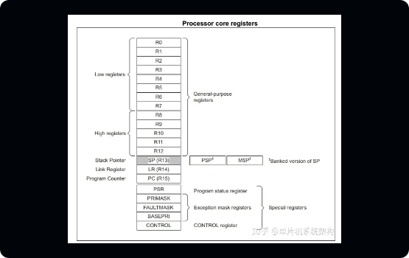
ARM Cortex-M Register Map
R0 – R12: General Purpose Registers for data processing.
R13 (SP): Stack Pointer. Points to the current stack top.
R14 (LR): Link Register. Stores return address for functions.
R15 (PC): Program Counter. Points to next instruction.
xPSR: Status flags (Z, N, C, V).
NOTE: Most ARM instructions operate directly on registers. R13, R14, and R15 have special hardware functions.

Slide 5
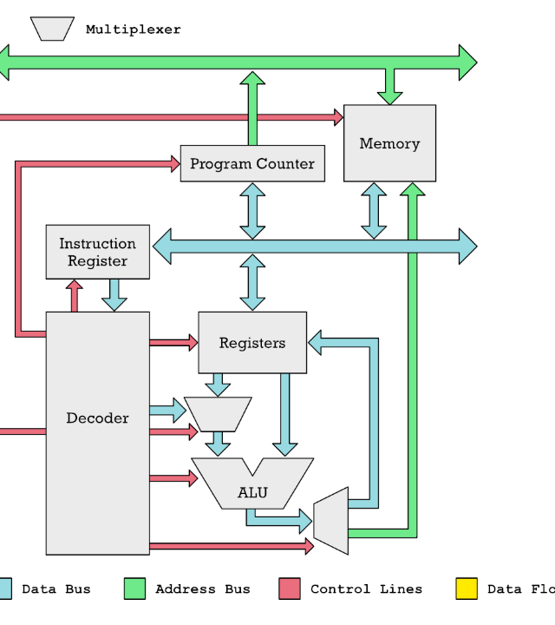
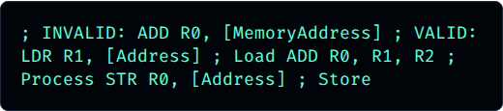
Load-Store Architecture
In ARM, memory is isolated from the ALU. You cannot perform arithmetic directly on RAM values.
This decoupling allows for higher clock speeds and deterministic timing in RTOS.
This is a very important ARM feature. The processor only manipulates data inside registers.

Slide 6




Memory Access & Stack
LDR / STR Ops
Stack Management
Basic memory access instructions.
Uses R13 (SP) to manage function context and local variables.
Supports offset, pre-index, and post-index addressing modes.
Note: Popping LR into PC performs an automatic function return.
Stack operations are critical in functions and interrupts to preserve the state of general-purpose registers.

Slide 7







Arithmetic Processing
ADD / SUB
MUL / MLA
ADC / SBC
Standard math operations.
Multiply and Multiply-Accumulate.
Add/Sub with Carry (for 64-bit ops).
Example: SUBS R0, R0, #1 (Decrement and update status flags)
Arithmetic instructions often update flags (using the 'S' suffix), which helps in making decisions.

Slide 8

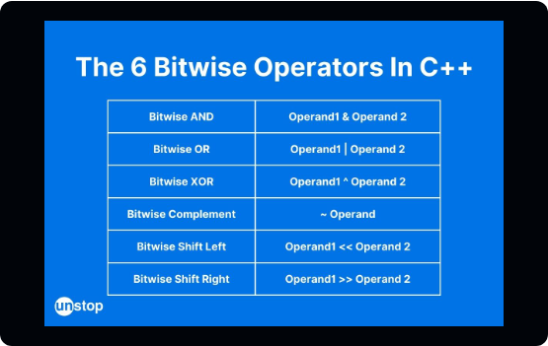

Logical Ops & Shifting
Bitwise Ops: AND, ORR, EOR (XOR), BIC (Bit Clear).
Barrel Shifter: Unique ARM feature to shift an operand during an ALU operation.
Bit operations are used heavily for peripheral registers. The barrel shifter provides 'free' scaling in many instructions.

Slide 9
Condition Flags & CMP
Status Flags (xPSR)
ZNCV
Z (Zero): Result was zero (Equal). N (Negative): Result bit 31 is set. C (Carry): Unsigned overflow. V (Overflow): Signed overflow.
STATUS FLAGS
CMP R0, #10 calculates (R0 - 10) and updates flags without saving the result.
CMP prepares the CPU for conditional branching by updating the status register flags.

Slide 10
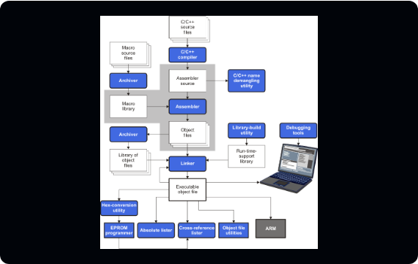

Control Flow & Branching
B: Unconditional Branch.
BEQ / BNE: Branch if Equal / Not Equal.
BL: Branch with Link (Function call).
This is how loops are built in assembly. SUBS updates flags, and BNE checks the Zero flag.

Slide 11






Memory Barrier Instructions
DMB
DSB
ISB
Data Memory Barrier. Ensures all memory access finishes before next memory operation.
Data Sync Barrier. Halts execution until memory access is complete.
Instruction Sync Barrier. Flushes pipeline and fetches new instructions.
Crucial for DMA, Interrupts, and Multicore synchronization.
Even if code is correct, hardware can reorder operations—barriers prevent race conditions in real-time peripherals.

Slide 12
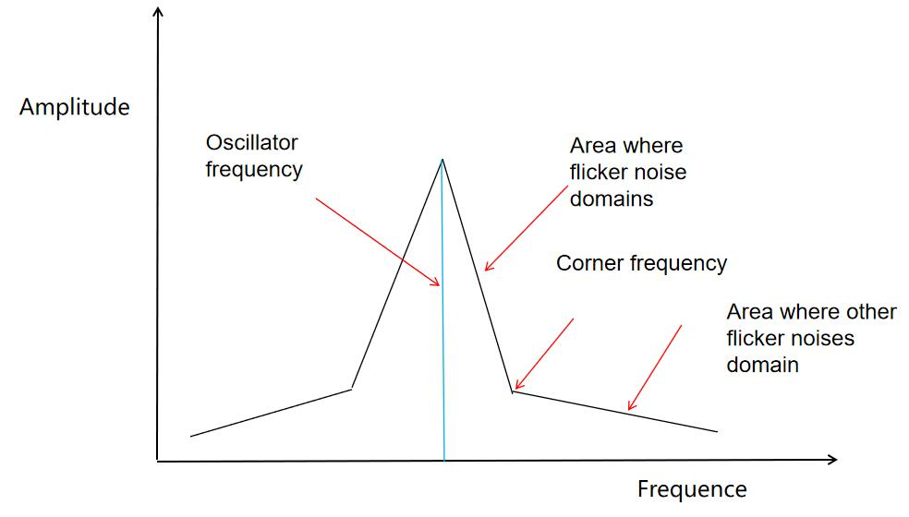
Arithmetic Saturation
Safe Clamping
Normal overflow "wraps around" (e.g., 127 + 1 = -128). Saturation clamps the result at the maximum or minimum limit.
Essential for: • DSP: Audio/Video filtering • Control: Motor torque limits • Sensors: Noise clamping
Saturation avoids dangerous 'wrap-around' values which can cause control instability in real-time systems.

Slide 13

Summary & Questions
We have explored the ARMv7-M Instruction Set, from fundamental Load-Store models to advanced Safety Barriers and DSP Saturation.
• Register Bank R0-R15 • LDR/STR & Stack Usage • Barrel Shifter Optimization
• Condition Flags & Branches • Pipeline Synchronization • Saturation Safety
Finish with 2–3 questions to make it interactive. Thank you for your time.

Slide 14


